Slide 1


PATCH FILE GENERATION

Slide 2
INDEX
Introduction to patch tool
Introduction to diff tool
Patch file creation with example
Patch file creation using git command
Adding patch file to git
Real time examples
Advantages of using patch file
References

Slide 3
INTRODUCTION TO PATCH TOOL
The computer tool patch is a Unix program that updates the text files according to instructions contained in a separate file , called patch file.
We can generate patch file using diff command as well as by using git.
A patch file is a text file that consists of a list of differences between the original file and the modified file.
Patch file is with extension of .patch (or) _patch.
Patch file is the best and easiest way to share changes to a document with colleagues, without having to send repetitive information.

Slide 4
INTRODUCTION TO diff Tool
diff is used to show the changes between two versions of the same file.
It will also tells us which lines in one file have is to be changed to make the two files identical.
Modern implementation also support binary files.
The output is called “diff” or “patch”.
The important thing to remember is that diff uses certain special symbols and instructions that are required to make two files identical. It tells you the instructions on how to change the first file to make it match the second file.

Slide 5
Patch file creation
Let us create a file(original file)
ORGINAL FILE:
#include<stdio.h>
void main()
{
printf(“M-ISS\n");
Printf(“my home twitza\n”);
}

Slide 6
Patch file creation
We created another file(updated file) which is the modified version of original file.
UPDATED FILE:
#include<stdio.h>
void main()
{
printf(“M-ISS\n");
printf(“Galaxy by Aurobindo\n");
printf(“All the best\n");
}

Slide 7
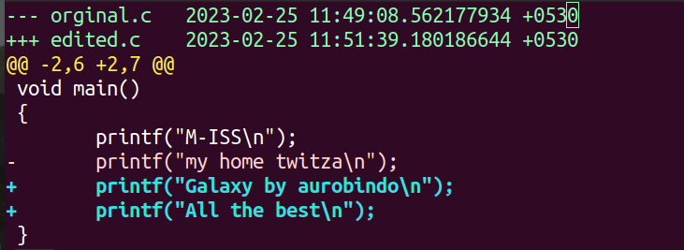
Patch file creation
Now we are creating patch file by using diff command with .patch extension.
We use command
$ diff -u <original file name> <updated file> > <patch file>

Slide 8
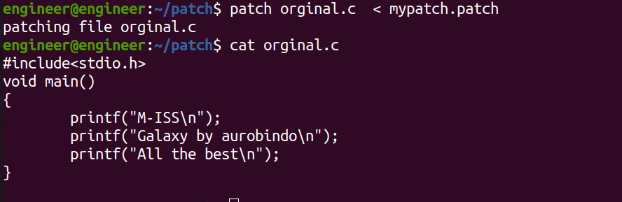
Now we generated patch file with .patch extension
If you want to again add changes to the original file we use command
$ patch <original file name> < <patch file name>

Slide 9
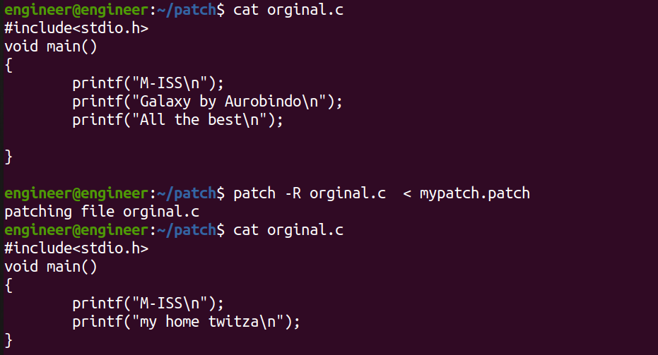
We can revert the changes in original file from patched to unpatch and vice versa by using below patch command
$ patch -R <original filename> < <patch filename>

Slide 10
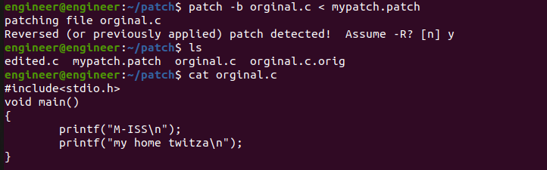
After patching if we don’t want the modifications we can unpatch by using command
$ patch -b <original file name> < <patch file name>
This command will also generate backup file of unpatched original file, with .orig extension

Slide 11
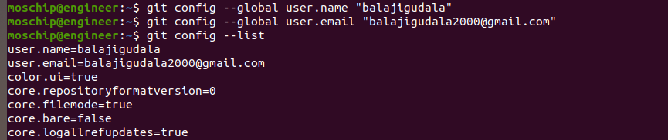
Patch file creation using git command
Signing in to the local git repository in our terminal :
Enter the directory in which you want to perform the operation.
Then initialize the git by using $ git init.
Then sign-in by giving our github username and email id.

Slide 12
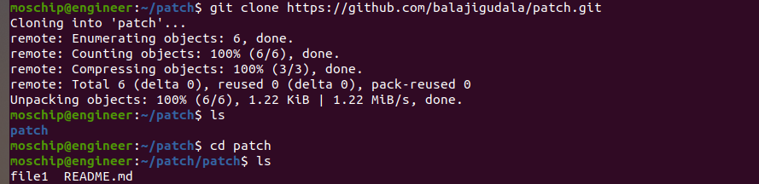
Clone a file from the global git repository by using command
$ git clone <url from git>
From above picture the file1 and README.md are been pulled from the global git repository.
Then do some updates on file1.

Slide 13
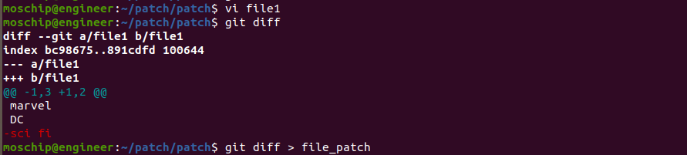
Then create a patch file using $ git diff command.
Here by using git diff if there are any modifications it will be shown on terminal in unified format.
If we want to store these modifications in a file we have to use redirect operator followed by file name.

Slide 14
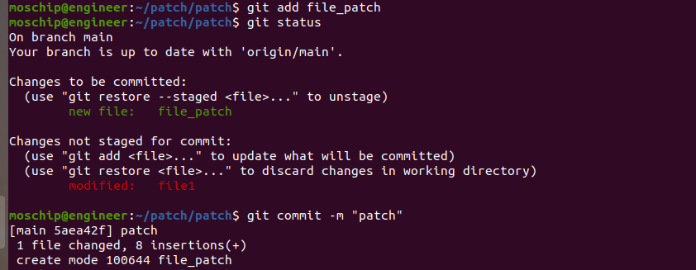
adding patch file to git
Then add and commit the patch file by using the commands
$ git add
$ git commit

Slide 15
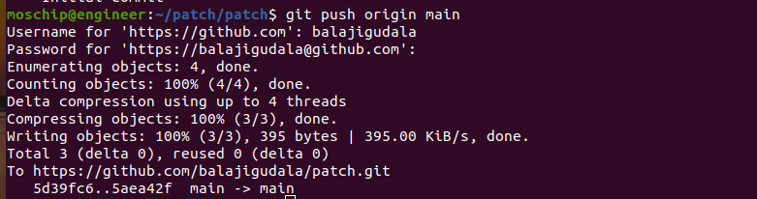
Then we are going to push the patch file to global repository by using command
$ git push origin <branch name>
After this command execution the patch file will be added to the global repository, based on their requirement they will add or detach the contain from the source file.

Slide 16
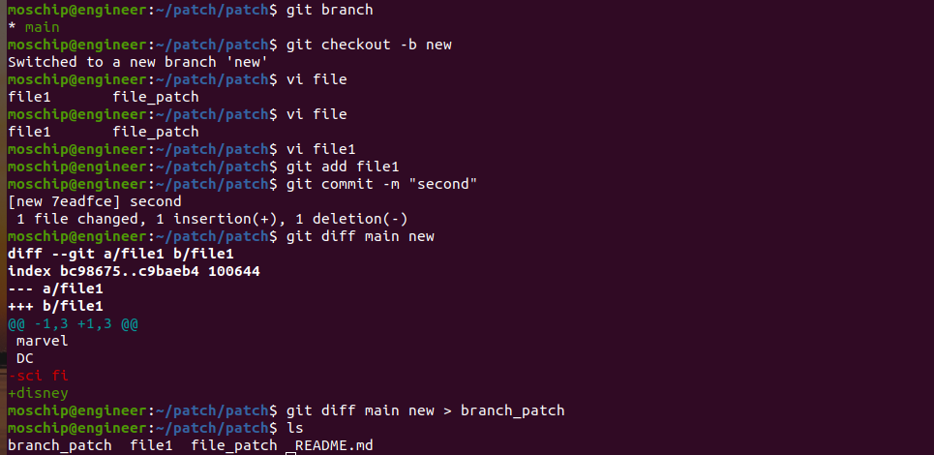
We can also create patch files not only on files but also we can create on branches or directories.
$ git diff <branch1> <branch2> > <file name>

Slide 17
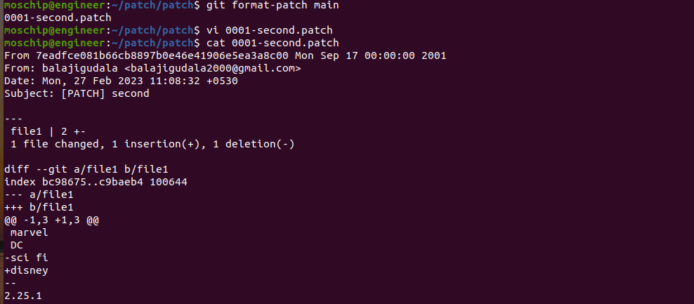
We can also create patch file by using a command
$ git format-patch <branch name>
(or)
$ git format-patch -1 <commit id>

Slide 18
real time examples
OS vendors
Application vendors
Network equipment vendors

Slide 19
Advantages of using patch file
We can easily send this patch file to your group during project.
Push and pop will be easy with git hub and other servers as patch file will take less space.
We can patch same source file with different directories at a time by using command
$ patch –p3 <folder1/file> <folder2/file> <folder3/file> < <patch name>

Slide 20
references
https://docs.moodle.org/dev/How_to_create_a_patch
https://docs.gitlab.com/omnibus/development/creating-patches.html
https://opensource.com/article/18/8/diffs-patches
https://www.oreilly.com/library/view/git-pocket-guide/9781449327507/ch11.html
https://linuxhint.com/run-patch-command-in-linux/#:~:text=In%20Linux%20operating%20system%2C%20%E2%80%9Cpatch,get%20the%20difference%20or%20patch.

Slide 21
Thank you

